Slide 1
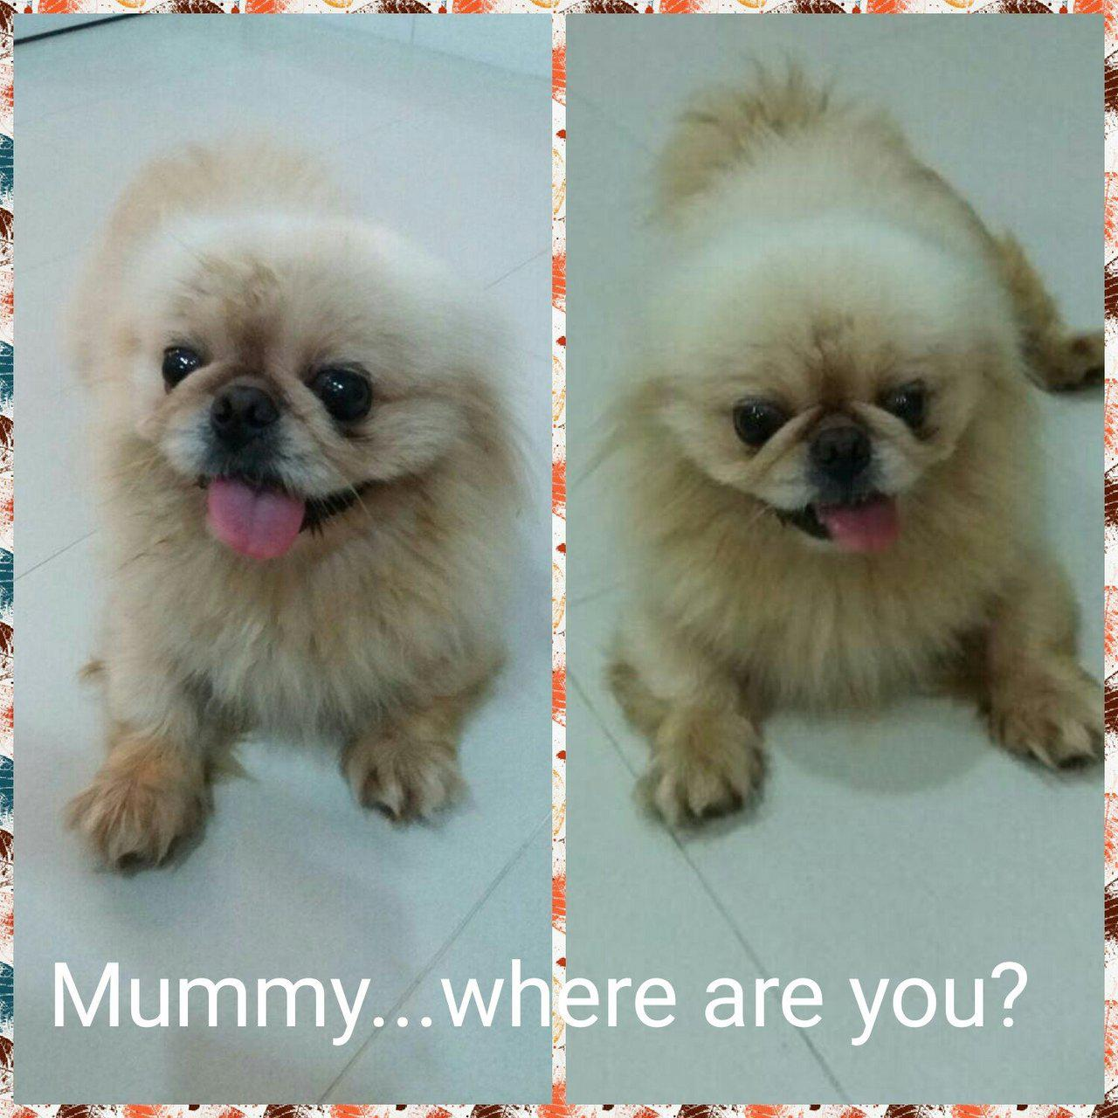
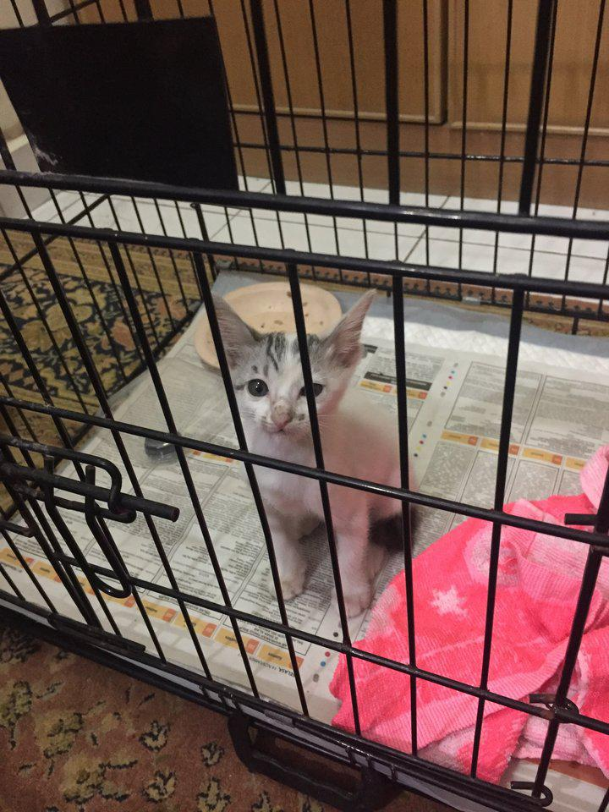
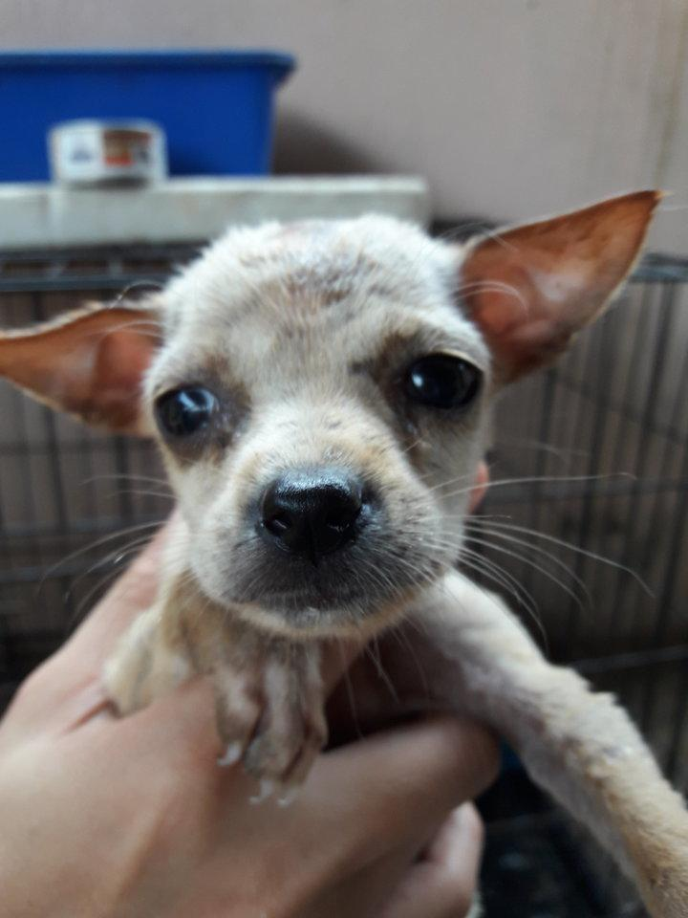
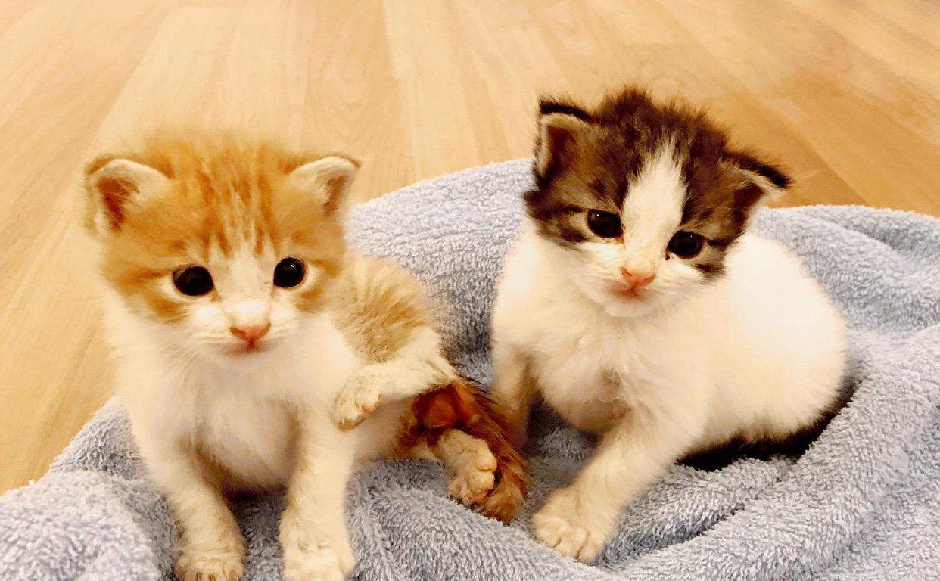
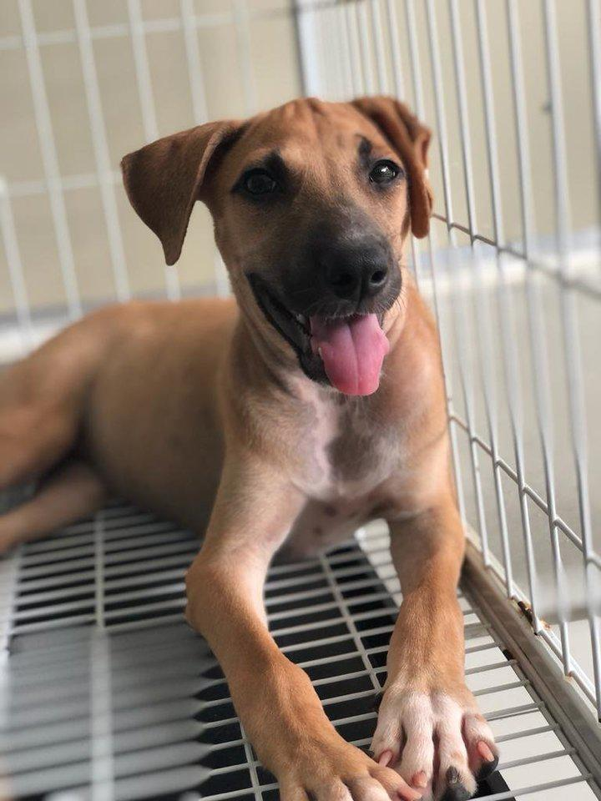
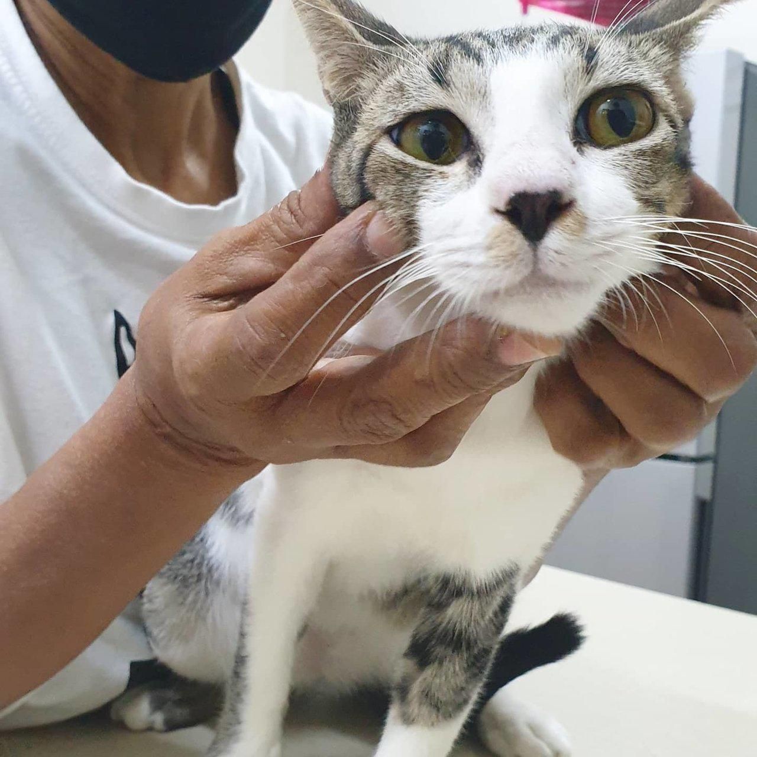
Predicting Pawpularity
Using Computer Vision and Deep Learning to Support Pet Adoption

Slide 2
Contents
What is pawpularity and why is it important?
Data – what do we have to work with?
Methods – how to get the best prediction?
CNN model
Preprocessing images
Testing and adjusting the model
Result

Slide 3

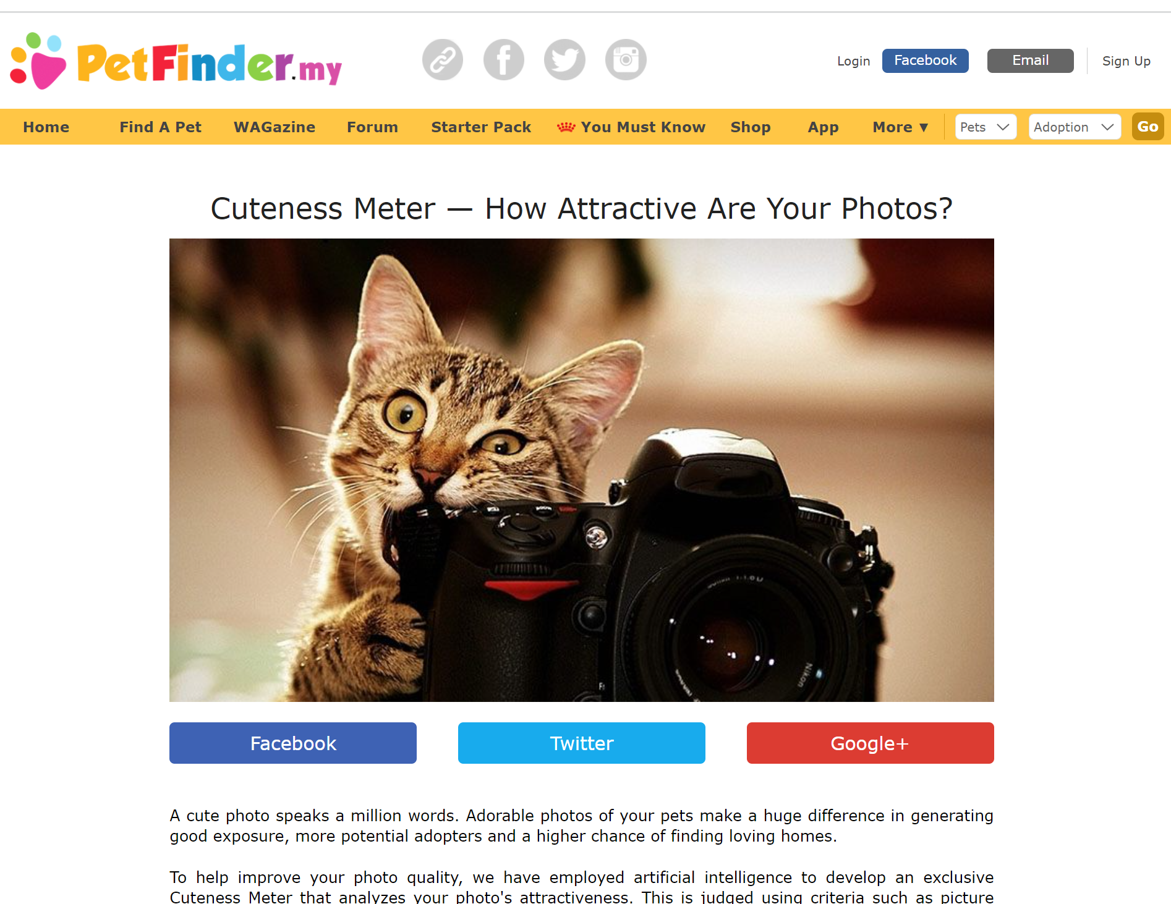
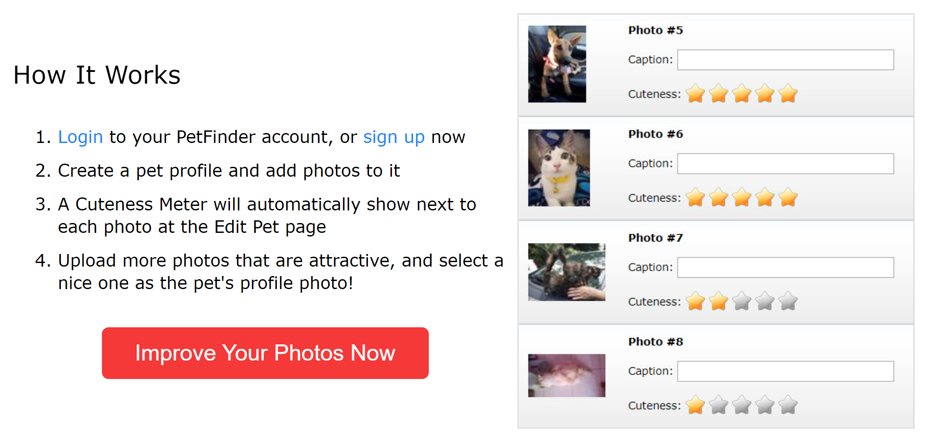

“PetFinder.my is Malaysia’s leading animal welfare platform, featuring over 180,000 animals with 54,000 happily adopted. PetFinder collaborates closely with animal lovers, media, corporations, and global organizations to improve animal welfare
A pet’s pawpularity score is based on internet traffic on pet’s profile

Slide 4
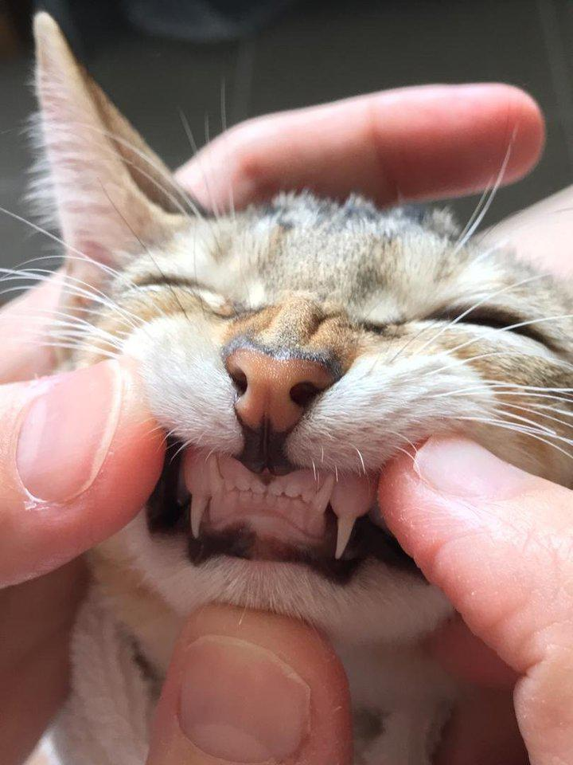
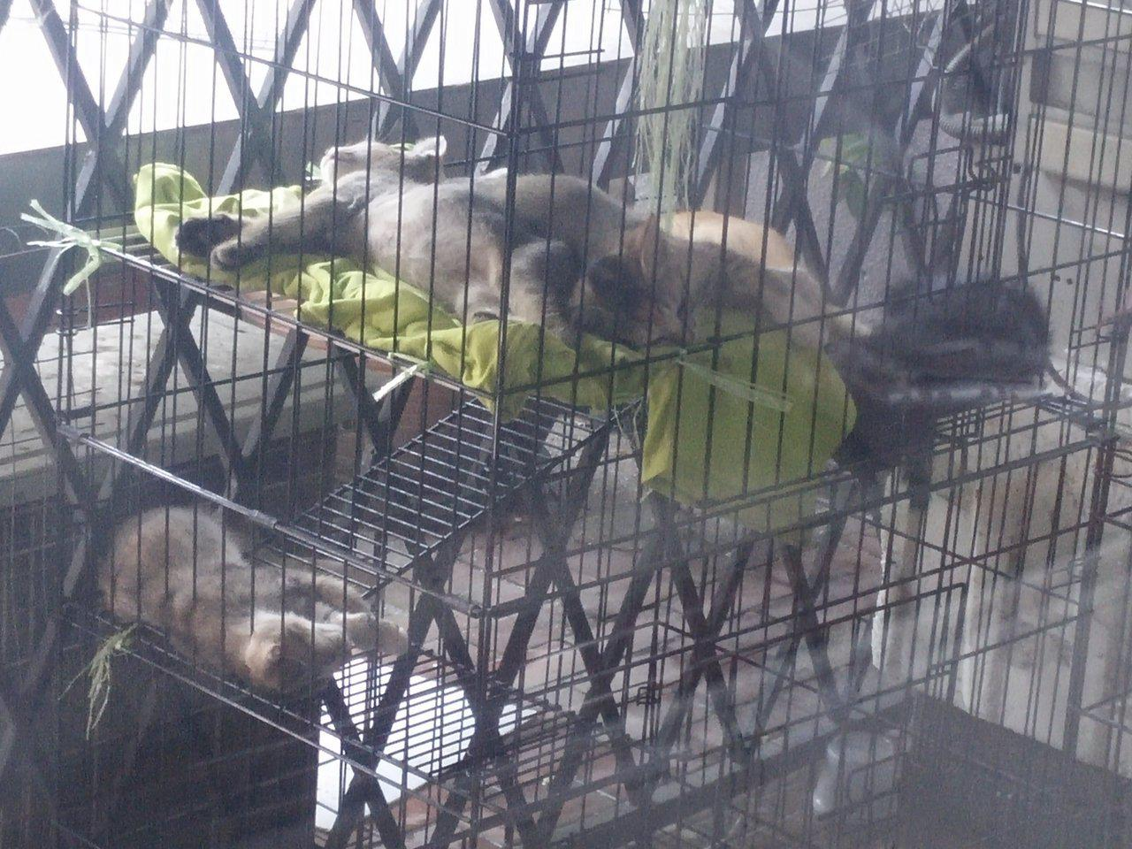
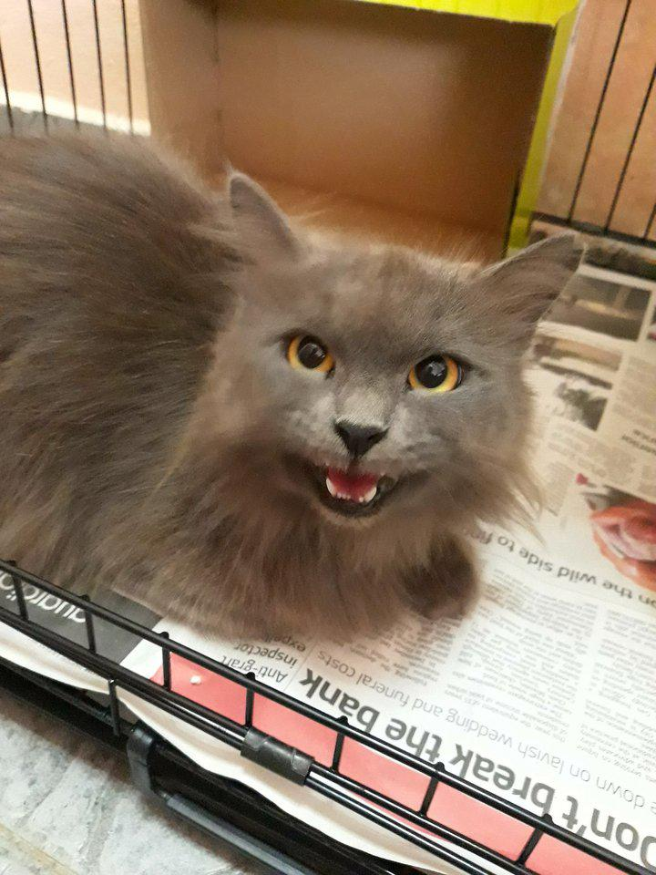
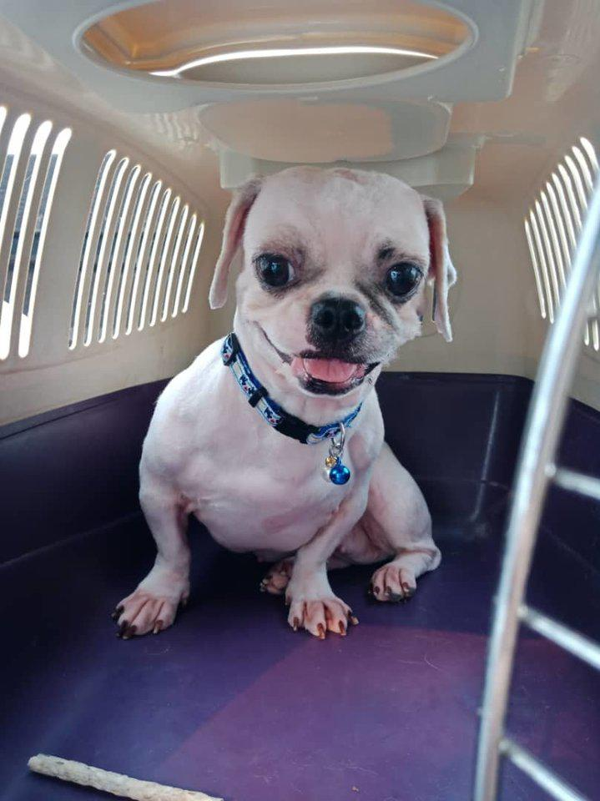
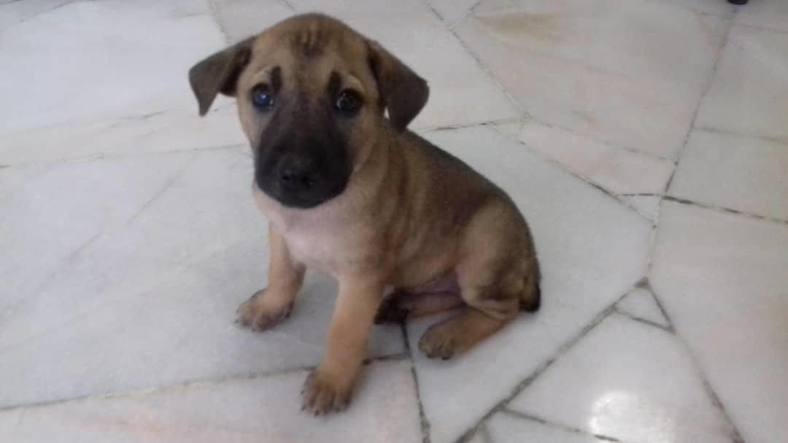
Data
Almost 10,000 images of dogs and cats in different qualities and sizes
For each image, 12 columns of metadata and the “Pawpularity” score
Pawpularity Score = 37
Pawpularity Score = 82
Pawpularity Score = 31
Pawpularity Score = 24
Pawpularity Score = 100
(???)

Slide 5
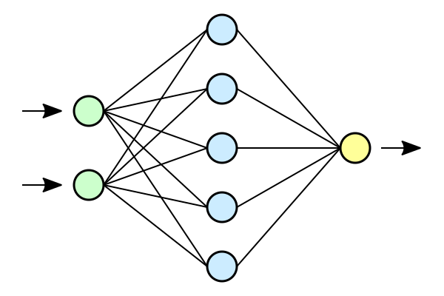
Chosen method: Convolutional Neural Network
Convolutional Neural Networks (CNNs, or ConvNets) are deep learning networks especially suited for analyzing image data.
CNNs are commonly used to classify images. To predict continuous data, a regression layer can be used at the end of the network.

Slide 6
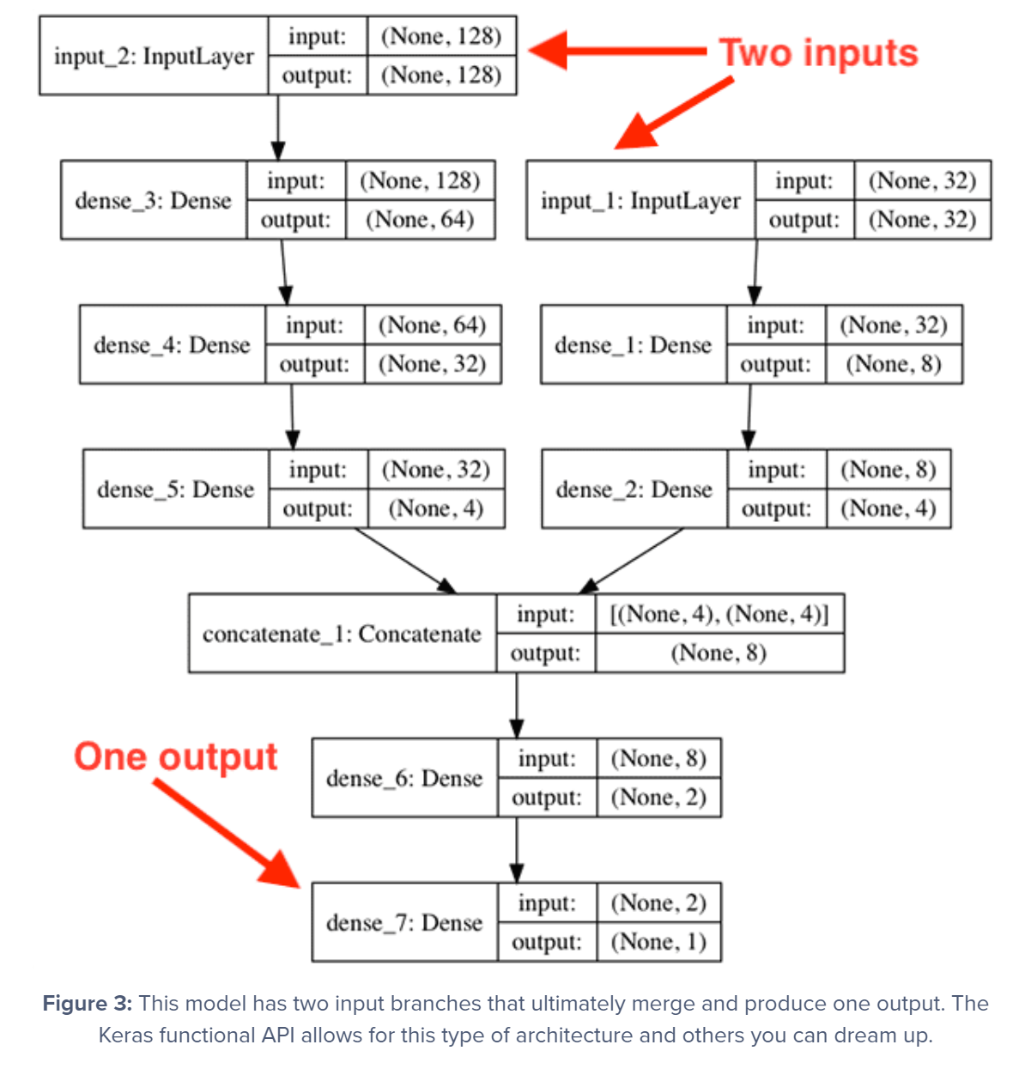
Only Computer Vision
Inputlayer
Inputlayer
Dense
Dense
Dense
Dense
Dense
Concatenate
Dense
Dense

Slide 7
Mixed Data
Inputlayer
Inputlayer
Dense
Dense
Dense
Dense
Dense
Concatenate
Dense
Dense

Slide 8
Model Performance (Root Mean Squared Error)

Slide 9
Model Performance (Mean Absolute Error)

Slide 10
Which one is the best model?
Only Metadata
CNN 1-layer
CNN 2-layer
Both MD
and CV
RMSE: 26.20
MAE: 18.73
RMSE: 20.43
MAE: 15.99
RMSE: 20.99
MAE: 16.93
RMSE: 21.67
MAE: 15.76

Slide 11
Key takeaways
Computer Vision and Deep Learning can be used to not only classify but also score images – CV can see things that we don’t
Overfitting and processing times are the main problem – finding a balance is the challenge

Slide 12
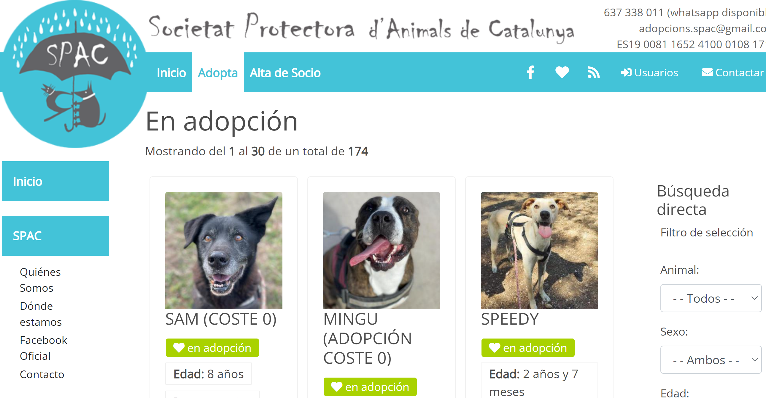
Before buying a pet, remember that there are tons out there looking for a home!
To adopt locally, go to https://spac.cat/

Slide 13
Sources
Information
https://www.mathworks.com/help/deeplearning/ug/train-a-convolutional-neural-network-for-regression.html
Images
Animal pictures from www.mypetfinder.my
Neural Network Image from https://commons.wikimedia.org/wiki/File:Neural_network.svg

Slide 14
Why did I use deep learning
Diagram of the layers
Success and failures
Why do I not have a perfect score

Slide 15
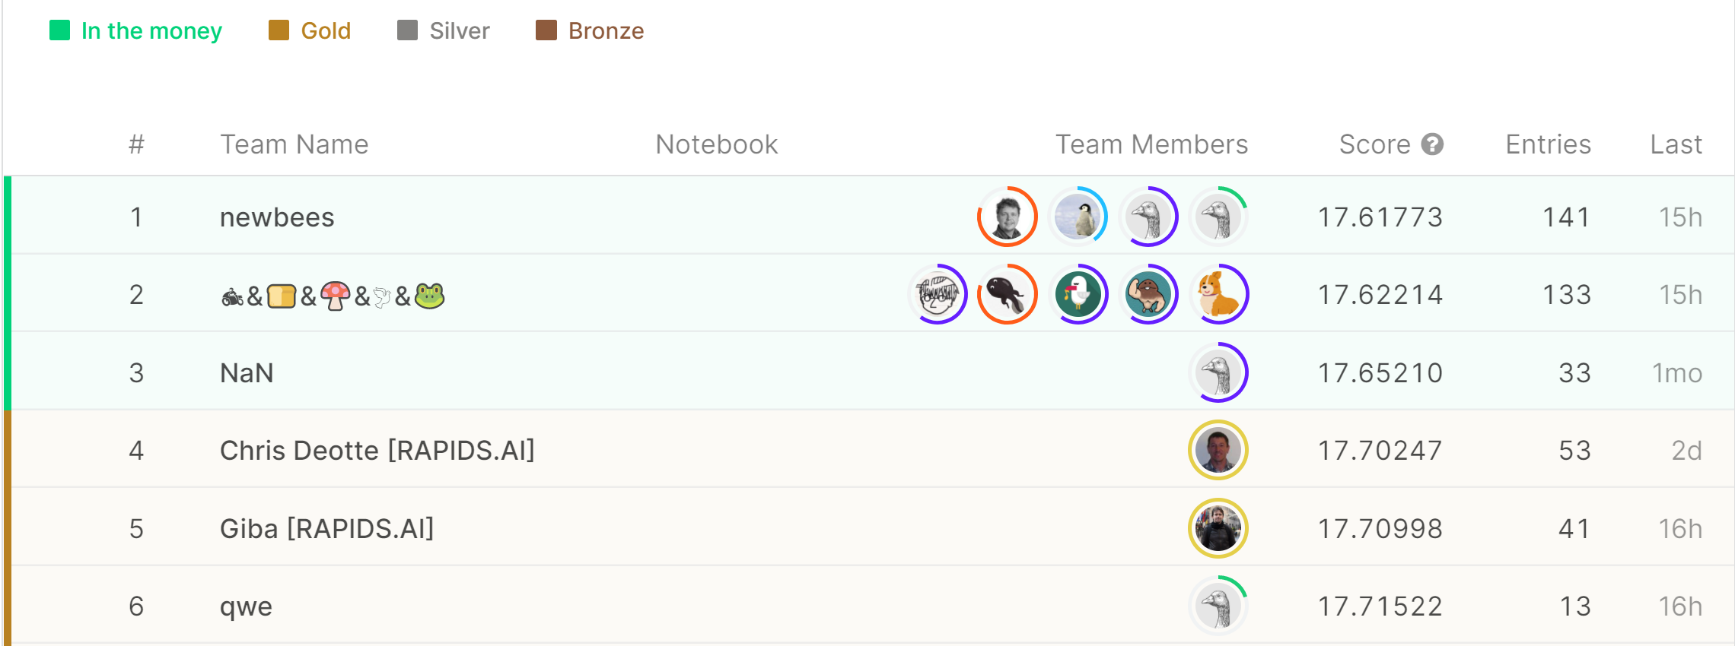

Slide 16
Pre-processing
Grayscaling images makes little sense
Can’t change the images significantly, since this might have a direct impact on pawpularity

Slide 17
ToDos today
Read image preprocessing article - check
Read article about testing and validation
Read Kaggle challenge data submission
Build simplified model - check
Check what is mean by K-Fold - check

Slide 18
Wishlist
Feature extraction: dog or cat
Check mean scores for statistically relevant samples from the data set regarding dog or cat
Classification of dog or cat

